Slide 1
Electricity Generation

Slide 2
Electricity Generation
Top 3 states according to the Total electricity generated by them between the years 2006 to 2016
Sr No. | State | Total Electricity Generated in MW
1 | Uttar Pradesh | 11,63,717
2 | Maharashtra | 10,95,011
3 | Gujarat | 10,87,795

Slide 3
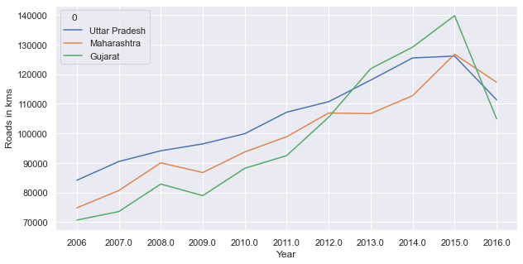
Electricity Generation in top 3 states
For All 3 top electricity generating states we can see that rate of electricity generation keep on increasing from year 2006 to 2015 and then decreases in year 2016.

Slide 4
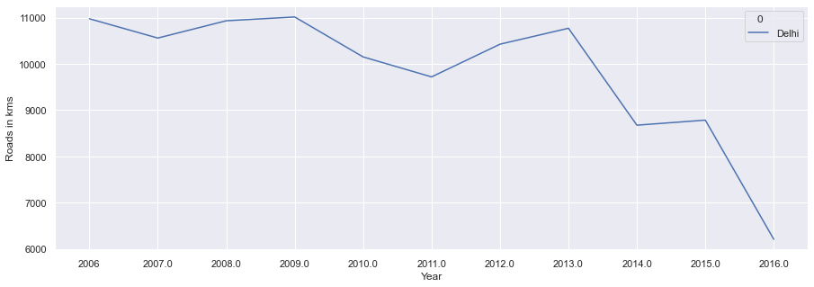
Electricity Generation in Delhi
For Delhi electricity generation rate Is quite fluctuating up and down over the years.
Overall there is a huge decrease in electricity generation in Delhi from year 2006 to 2016

Slide 5
Electricity Generation capacity
Sr No. | State | Total electricity generated (MW) | Solar Potential in MW | Grid connected solar Project capacity in MW | Rooftop Capacity in MW | Solar pumps installed in No’s
1 | Uttar Pradesh | 1163717 | 22.83 | 960 | 83.23 | 9588
2 | Maharashtra | 1095011 | 64.32 | 1633 | 186.24 | 1000
3 | Gujarat | 1087795 | 35.77 | 2440 | 202.47 | 3537

Slide 6
Solar Potential in MW
We can see Maharashtra has very good solar energy potential
The reason for this is its geographical location and major area is having large span of summer.

Slide 7
Grid connected solar Projects Capacity in MW
Grid connected solar project are mostly in Gujarat
Maharashtra and Uttar Pradesh is also having good number of this solar projects

Slide 8
Rooftop Capacity in MW
For Maharashtra & Gujarat Rooftop capacity is almost same as this are much developed states
Also people & industries in this are more aware about the benefits of solar energy.

Slide 9
Solar Pumps installed in No’s
Uttar Pradesh is leading in case of solar pumps this might be because of water irrigation requirement in this states.

Slide 10
Wind Power potential in MW
For Gujarat wind potential is higher due to its geographical location.
This state is aligned closely with Arabian sea.
Maharashtra is also having large Coastal Region but the potential is low in overall considerations.

Slide 11
Wind power installed capacity in MW
As discussed in last slide as Gujarat has higher wind potential so the wind power station installed are also higher in this state as compared to others.

Slide 12
Total investments towards renewable energy project implementations in top 3 states
Sr No. | State | Funds in lakhs(2017-18) | Funds in lakhs(2018-19)
1 | Gujarat | 2621.87 | 0
2 | Uttar Pradesh | 2828.32 | 0
3 | Maharashtra | 0.00 | 300

Slide 13
Union Territory Electricity Generation
Top 3 Union Territories according to the Total electricity generated by them between the years 2006 to 2016
Jammu & Kashmir
Delhi
Puducherry

Slide 14
Union Territories
Electricity generation rate is almost constant for Puducherry.
For Delhi Electricity generation rate decreasing
For Jammu & Kashmir there is continuous increase seen in electricity generation rate.

Slide 15
Electricity generation capacity in top 3 Union territory
States | Total electricity generated | Solar Potential | Grid connected solar Project capacity | Rooftop Capacity
Jammu & Kashmir | 126749.11 | 111.05 | 14.83 | -
Delhi | 108240.65 | 2.05 | 126.89 | -
Puducherry | 4080.41 | - | - | 1.77

Slide 16
Roads Construction Analysis

Slide 17
Assumptions
Roads construction data for some union territories and smaller states are not available so I assumed it to be zero for those particular years.
Reason for assumption: I did it because if we think logically as this states are smaller and not having developed cities so there will be lesser road construction every year as compared to other states and our main focus is to target top 3 states.

Slide 18
National Highways
Top 3 states according to the Total kms of Road constructed:
Uttar Pradesh
Rajasthan
Madhya Pradesh

Slide 19
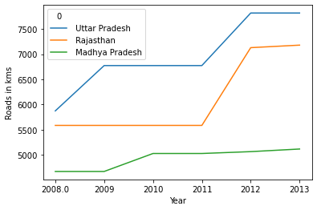
National Highways
Max Road Construction is done in Uttar Pradesh State
In Uttar Pradesh & Rajasthan states there is drastic increase in road construction in the year 2012 as compared to previous trend.
For Madhya Pradesh Road construction is almost constant each year after 2010.

Slide 20
State Highways
Top 3 states according to the Total kms of Road constructed:
Maharashtra
Karnataka
Gujarat

Slide 21
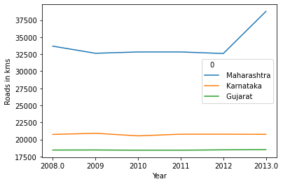
State Highways
Max Road Construction is done in Maharashtra State
There is a sudden increase in Road construction rate in Maharashtra between year 2012 and 2013
For Karnataka & Gujarat Road construction rate is almost constant every year.

Slide 22
Pwd Roads
Top 3 states according to the Total kms of Road constructed:
Andhra Pradesh
Arunachal Pradesh
Assam

Slide 23
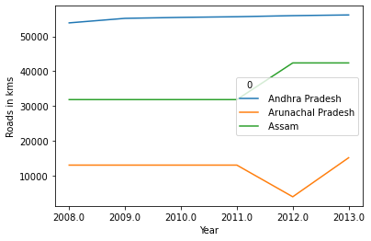
Pwd Roads
Max Road Construction is done in Andhra Pradesh State
There is a sudden decrease in Road construction rate in Arunachal Pradesh between year 2011 and 2012 &again increase in year 2013 to the same level as before year 2012
For Andhra Pradesh construction rate is almost constant every year.
For Assam Road construction increased in year 2012 and constant after that.

Slide 24
Urban Roads
Top 3 states according to the Total kms of Road constructed:
West Bengal
Uttar Pradesh
Karnataka

Slide 25
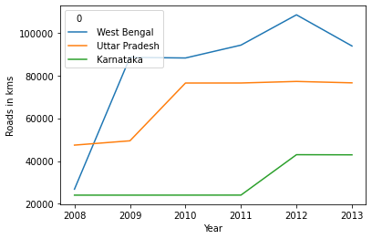
Urban Roads
Max Road Construction is done in West Bengal State
For west Bengal there is a drastic change in Road construction in 2009 it increased 3.5 times of that in year 2008
Again there is slow increase in Road construction rate from 2009 to 2012 for West Bengal
For karnataka state Road construction rate doubles from year 2012

Slide 26
Project Roads
Top 3 states according to the Total kms of Road constructed:
Uttar Pradesh
Madhya Pradesh
Maharashtra

Slide 27
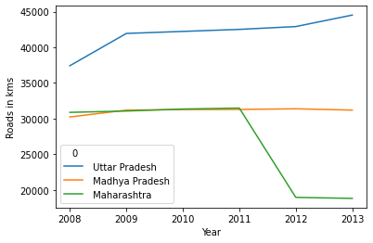
Project Roads
Max Road Construction is done in Uttar Pradesh State
For Madhya Pradesh Road Construction rate is almost constant
There is slow increase in Road construction rate from 2009 to 2013 for Uttar Pradesh
For Maharashtra Road Construction rate is decreased after year 2011

Slide 28
Rural Roads
Top 3 states according to the Total kms of Road constructed:
Assam
Orissa
Maharashtra

Slide 29
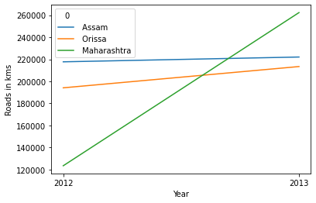
Rural Roads
As the data is available only for 2 years Based on that we can say there is Major increase in Road Construction in Maharashtra in year 2013
For Assam And Orissa Road Construction rate is increase slightly in year 2013.

Slide 30
Road Per Person
Sr No. | State | Total Urban Road | Total Rural Road | Total | Population as on 2013 | Road per person
0 | West Bengal | 499755 | 356550 | 856305 | 91276115 | 0.009381
1 | Uttar Pradesh | 403603 | 200881 | 604484 | 199812341 | 0.003025
2 | Karnataka | 182189 | 326710 | 508899 | 61095297 | 0.008330
3 | Delhi | 175370 | 0 | 175370 | 16787941 | 0.010446
4 | Gujarat | 128011 | 105310 | 233321 | 60439692 | 0.003860
5 | Maharashtra | 122632 | 385868 | 508500 | 112374333 | 0.004525
6 | Tamil Nadu | 115043 | 282682 | 397725 | 72147030 | 0.005513
7 | Orissa | 110416 | 407597 | 518013 | 41974218 | 0.012341
8 | Kerala | 91027 | 280149 | 371176 | 33406061 | 0.011111
9 | Madhya Pradesh | 86336 | 214333 | 300669 | 72626809 | 0.004140
10 | Andhra Pradesh | 82660 | 332542 | 415202 | 84580777 | 0.004909

Slide 31
Sr No. | State | Total Urban Road | Total Rural Road | Total | Population as on 2013 | Road per person
11 | Rajasthan | 75491 | 196345 | 271836 | 68548437 | 0.003966
12 | Punjab | 62556 | 122395 | 184951 | 27743338 | 0.006667
13 | Bihar | 57254 | 276338 | 333592 | 104099452 | 0.003205
14 | Haryana | 52193 | 9106 | 61299 | 25351462 | 0.002418
15 | Chhattisgarh | 45002 | 49757 | 94759 | 25545198 | 0.003709
16 | Assam | 36577 | 439821 | 476398 | 31205576 | 0.015266
17 | Uttra Khand | 25041 | 10984 | 36025 | 10086292 | 0.003572
18 | Himachal Pradesh | 12847 | 25730 | 38577 | 6864602 | 0.005620
19 | Chandigarh | 10056 | 0 | 10056 | 1055450 | 0.009528
20 | Jammu & Kashmir | 9995 | 19075 | 29070 | 12541302 | 0.002318
21 | Pudducherry | 4687 | 2414 | 7101 | 1247953 | 0.005690

Slide 32
Sr No. | State | Total Urban Road | Total Rural Road | Total | Population as on 2013 | Road per person
22 | Goa | 3718 | 11097 | 14815 | 1458545 | 0.010157
23 | Jharkhand | 3146 | 24382 | 27528 | 32988134 | 0.000834
24 | Mizoram | 2022 | 4664 | 6686 | 1097206 | 0.006094
25 | Tripura | 1571 | 34932 | 36503 | 3673917 | 0.009936
26 | Manipur | 1093 | 14315 | 15408 | 2855794 | 0.005395
27 | Sikkim | 594 | 5744 | 6338 | 610577 | 0.010380
28 | Nagaland | 585 | 45903 | 46488 | 1978502 | 0.023497
29 | Meghalaya | 511 | 3406 | 3917 | 2966889 | 0.001320
30 | A. & N. Islands | 493 | 0 | 493 | 380581 | 0.001295
31 | Arunachal Pradesh | 244 | 8607 | 8851 | 1383727 | 0.006396
32 | Daman and Diu | 216 | 222 | 438 | 243247 | 0.001801
33 | Lakshadweep | 14 | 0 | 14 | 64473 | 0.000217
34 | D. & N. Haveli | 0 | 0 | 0 | 343709 | 0.000000

